Slide 1



TechWave Talk
Data Analytics – Turning Data into Insights
YASHI GUPTA
I- 4
3 Feb 2025

Slide 2



What is data ?...
It can be anything—numbers, words, pictures, or even sounds—that is collected and stored for a purpose. For example:
Your name and phone number in your phone contacts? That’s data.
The number of steps you take in a day on your fitness app? That’s data.
A list of movies you’ve watched on Netflix? Also data!
page 02

Slide 3
Historical
Did you know?
Context
Data analytics isn’t just a modern concept—it dates back to ancient times! Egyptians recorded tax data on papyrus, and in the 1800s, Florence Nightingale used data visualization to improve healthcare. Fast forward to the 1950s, computers revolutionized data processing, and by the 2000s, Big Data and AI took over. Today, data analytics helps businesses, predicts trends, and even powers social media algorithms! 🚀📈

Slide 4
Understanding Data Analytics in Everyday Decisions
🛍 Choosing the fastest checkout line – You quickly analyze line length and cashier speed. 🚶‍♀️ Crossing the road – You judge car speed and distance to decide when to walk. 📞 Deciding when to call someone – You recall past responses to pick the best time. 🍽 Picking a restaurant – You consider reviews, past experiences, and wait times. 📚 Studying for exams – You track which topics you struggle with and focus on them. 🏡 Turning off appliances – You analyze usage patterns to save electricity.

Slide 5
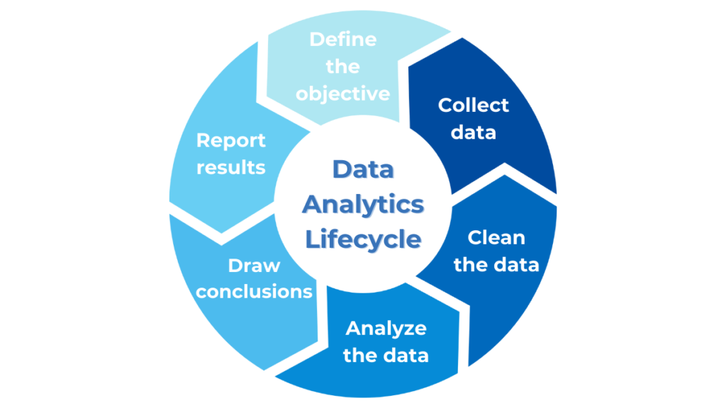
STEPS INVOLVED

Slide 6
EXAMPLE + LIFECYCLE
Objective: You want to pick the fastest checkout line to save time.
Collect Data: Look at how long the lines are and how fast the cashiers are.
Clean Data: Ignore anything unusual, like a customer causing a delay.
Analyze Data: Compare the lines based on length and cashier speed to estimate wait times.
Draw Conclusions: Choose the line with the shortest wait time.
Report Results: Pick the fastest line and go!

Slide 7

CHRISTMAS PARTY PLANNING
As we have learned till now that we use data analytics without even realizing it, incorporate it in our day-to-day decisions. Christmas party planning is an example focusing and classifying it into different steps included in the data analytics lifecycle.

Slide 8




STEP 1
Plan
Identify the group for the party (e.g., family, friends, colleagues).
Ask the right questions to tailor the party to the selected group.
Decide on the type of party (e.g., indoor/outdoor, themed/non-themed).
Choose a theme (ICONIC CHRISTMAS VILLAINS) and create a guest list.

Slide 9

STEP 2
Prepare:
Allocate funds for the party.
Gather data on food preferences (e.g., vegan, vegetarian, non-vegetarian).
Decide on games , food preferences and activities by sending out polls to guests.

Slide 10

STEP 3
Process:
Finalize the menu based on poll results.
Plan the timeline for games and activities.
Decide on gifts and explore cost-cutting options (e.g., DIY gifts).

Slide 11
STEP 4
Analyze:
Compare pricing options for venues, catering, and decorations.
Ensure the total cost stays within the budget.
Identify areas for adjustments (e.g., choosing a smaller venue).

Slide 12
STEP 5
Communicate:
Communicate finalized details to guests:
Send invitations with date, time, location, and dress code.
Share activity details and assign roles for games.
Confirm RSVPs and finalize food and seating arrangements.

Slide 13
STEP 6
Act:
Purchase decorations, gifts, and party supplies.
Set up the venue and decorations.
Host the party, make adjustments as needed, and enjoy!

Slide 14


IMDB MOVIE DATA ANALYSIS
📌 Now, let's explore how Excel can be used for Data Analytics!
🔍 We will analyze an IMDB movie dataset to uncover trends in ratings,
genres, revenue, and more.
⚡ Using Excel tools like data cleaning, pivot tables, charts, and statistical functions, we can transform raw data into valuable insights.
📊 This analysis helps us understand what makes a movie successful and how data-driven decisions shape the film industry.

Slide 15
Key Insights from IMDB Movie Analysis
📌 Movie Genre Analysis:
Comedy, Drama, Action, and Adventure have higher average IMDB ratings than Horror.
Used =AVERAGEIF(range, criteria, average_range) to find average ratings by genre.
📌 Movie Duration Analysis:
No strong correlation between movie duration and ratings.
Used =CORREL(duration_range, rating_range) for correlation analysis

Slide 16
📌 Language Analysis:
English movies dominate high ratings, but non-English films (e.g., Japanese, Spanish) have niche popularity.
Used =COUNTIF(language_range, "English") for frequency analysis.
📌 Director Analysis:
Top directors like Nolan and Spielberg consistently have high ratings.
Used =AVERAGEIF(director_range, criteria, rating_range) to find average ratings per director.

Slide 17

📌 Budget Analysis:
Higher budgets often lead to higher earnings, but profit margins vary.Used Profit Margin = (Gross - Budget) / Budget to calculate profitability.
🔍 All analysis was performed in Excel using formulas, pivot tables, and charts!

Slide 18


Challenges
Faced
Missing & inconsistent data required cleaning and handling null values.
Outliers affected trends, requiring filtering.

Slide 19

Future
Prospects
AI & Machine Learning: Smarter predictions and automation for better decisions.
Real-Time Analytics: Instant insights from live data for quick actions.
Data Privacy & Ethics: Focus on secure, fair, and transparent data use.
Self-Service Tools: Non-experts can analyze data easily without help.
Industry-Specific Solutions: Tailored analytics for healthcare, finance, retail, etc.

Slide 20

Conclusion
1. Data is Everywhere: From everyday decisions to complex business strategies, data plays a vital role in shaping outcomes.
2. Data Analytics Lifecycle: The process involves defining objectives, collecting and cleaning data, analyzing it, and drawing actionable insights.
3. Real-Life Applications: Whether planning a party or analyzing movie trends, data analytics simplifies decision-making and uncovers patterns.
4. Excel as a Powerful Tool: Excel’s formulas, pivot tables, and charts make data analysis accessible, even for non-experts.
5. Future is Data-Driven: With advancements in AI, real-time analytics, and industry-specific solutions, data analytics will continue to revolutionize decision-making across fields.

Slide 21
Q & A

Slide 22
THANK YOU!
MORE INFORMATION CONTACT : gupta1803yashi@gmail.com

